Slide 1



A Probabilistic Choreography Language for PRISM
Marco Carbone¹, Adele Veschetti²
¹IT University of Copenhagen
²TU Darmstadt
IMT Lucca
11th February 2025

Slide 2


outline
1 Motivation
2 Choreographic Language
3 PRISM Language
4 Projection
5 Implementation
6 Conclusions

Slide 3
motiVATION

Slide 4
MOTIVATION
High level language for concurrent systems that compiles into PRISM
Advantage: higher abstraction => easier to write correct things

Slide 5
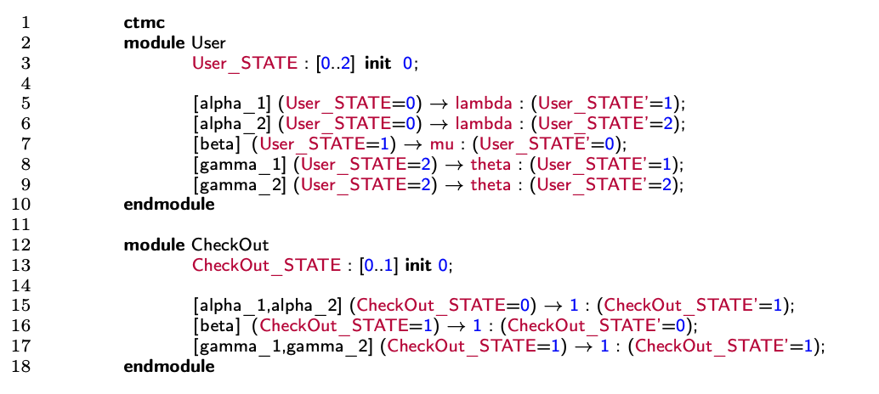

Prism¹
PRISM has a declarative approach
Very easy to add commands
Very hard to predict what their effect is on the system as a whole
PRISM language for modelling concurrent systems
Based on a declarative version of CSP (with probabilities/rates)
https://www.prismmodelchecker.org/
Conditions
Rates
Labels
High risk of modelling something else than what was intended
Updates
[1] Marta Kwiatkowska, Gethin Norman and David Parker. PRISM 4.0: Verification of Probabilistic Real-time Systems. In Proc. 23rd International Conference on Computer Aided Verification (CAV’11), volume 6806 of LNCS, pages 585-591, Springer, 2011

Slide 6
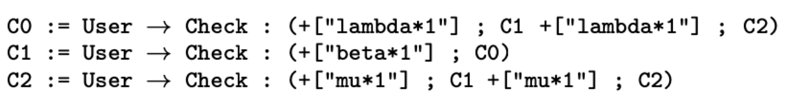
choreographies
Describe communication-based systems focusing on global flow of messages
Global viewpoint of an entire system
Entities have a common goal
No single point of control
Only focus on communications
Facilitate the automatic generation of decentralised implementations
3 Choreographies
Continuations
Processes Interactions

Slide 7
example

Slide 8
CHOREOGRAPHIC CALCULUS

Slide 9






syntax
Interaction initiated by module p with modules p_{i}
λ_{j} denotes either a probability or a rate
Once a branch j is taken, the choreography will execute some assignments u_{j}
If-Then-Else: module p evaluates the guard E and then branches accordingly
(Possibly recursive) procedure call
End of the computation
Assignment: the value obtained by evaluating expression E is assigned to variable x
Update: assignments can be concatenated with the operator &

Slide 10
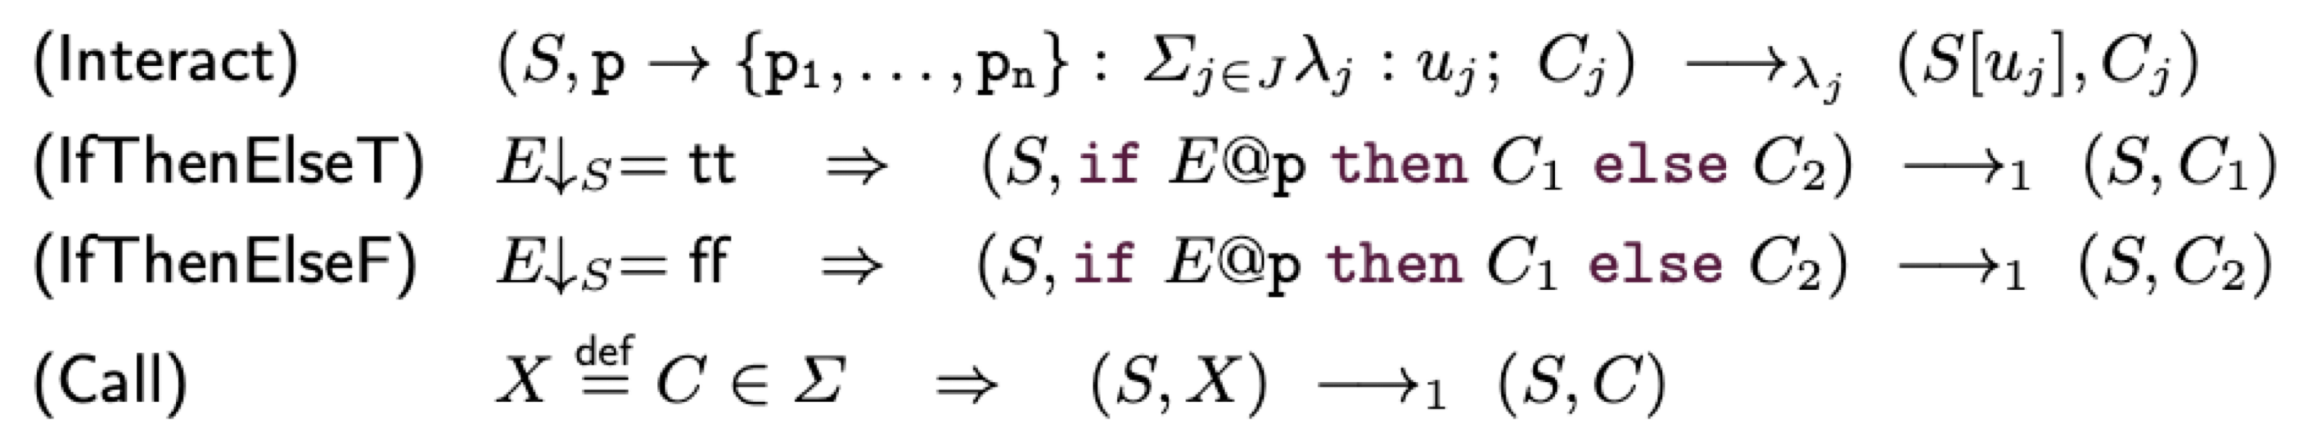
semantics
The transition relation is a Discrete Time Markov Chain (DTMC) or a Continuous Time Markov Chain (CTMC) depending on whether we use probabilities or rates in the branching construct

Slide 11
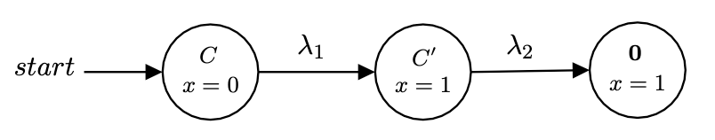
First Example
Semantics of C from the state S(x) = 0

Slide 12
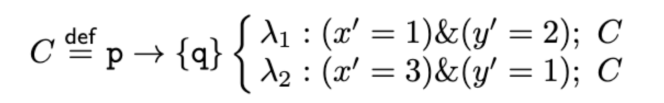
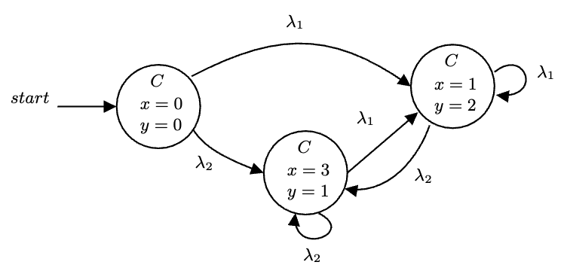
SECOND Example
Semantics of C from the state S(x) = S(y) = 0

Slide 13
PRISM LANGUAGE

Slide 14
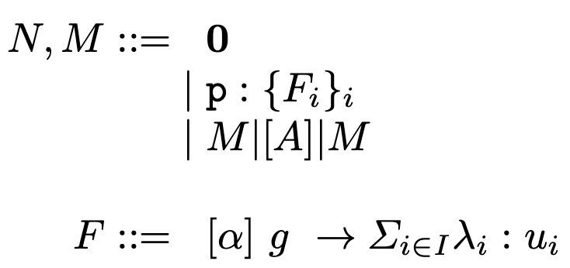





syntax
Networks
Empty Network
Module
Parallel Composition
Commands

Slide 15
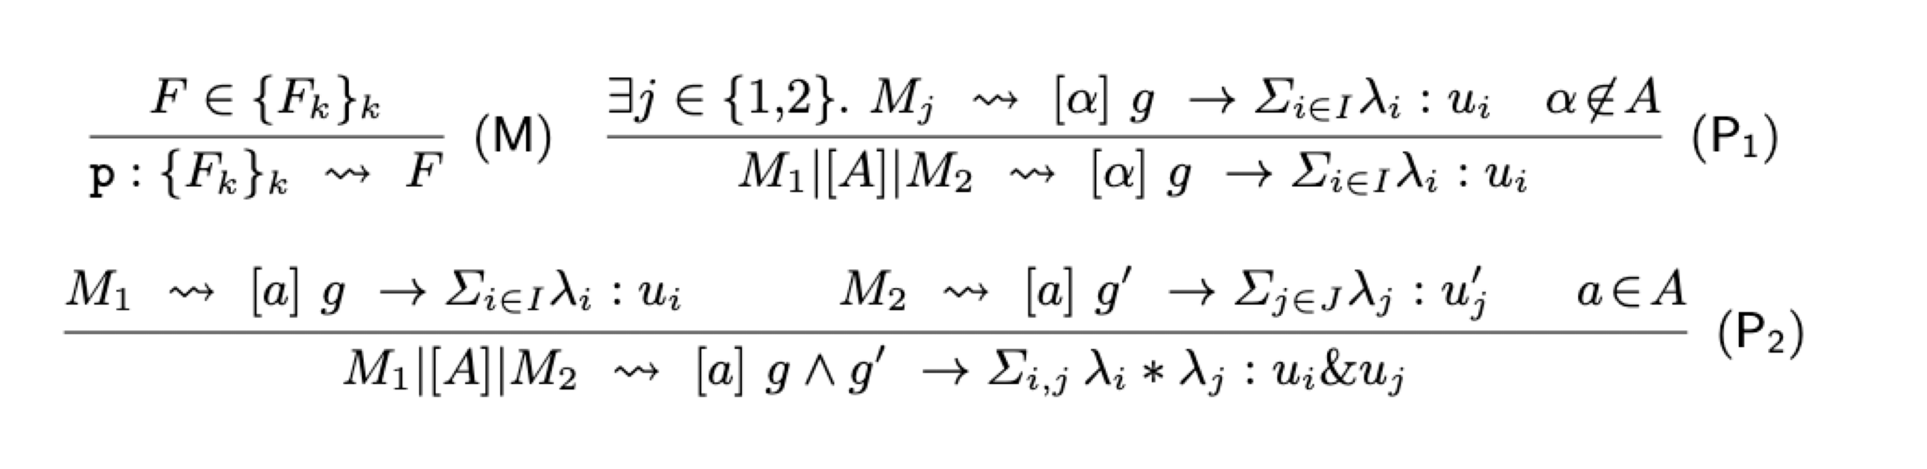
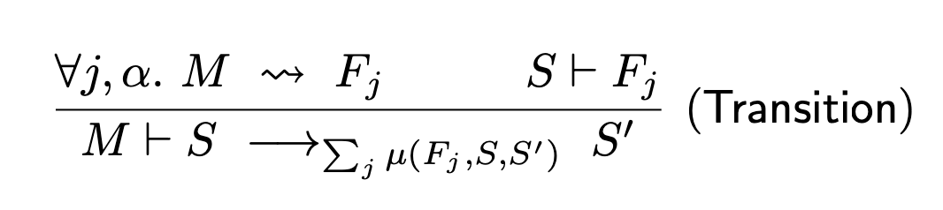



semantics
(M) exposes a command at network level
(P1) propagates a command through parallel composition if α is empty or a is not in A
(P2) the product of the probabilities/rates must be taken by extending the two different branches to every possible combination

Slide 16
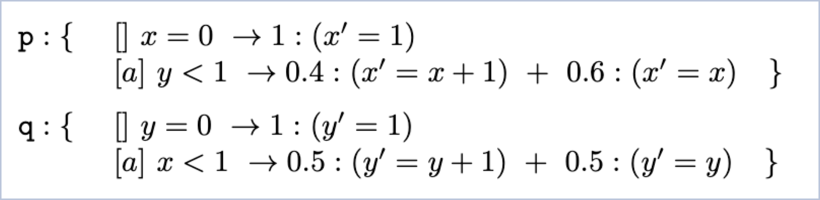
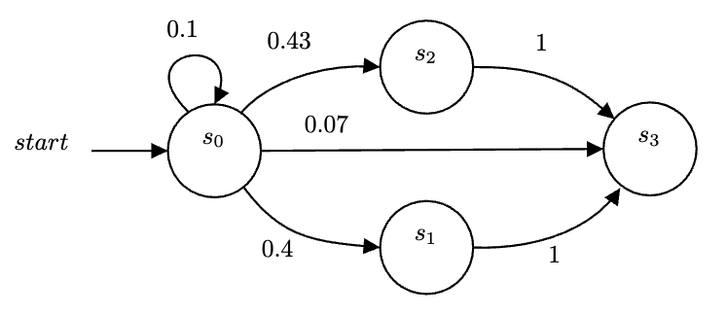
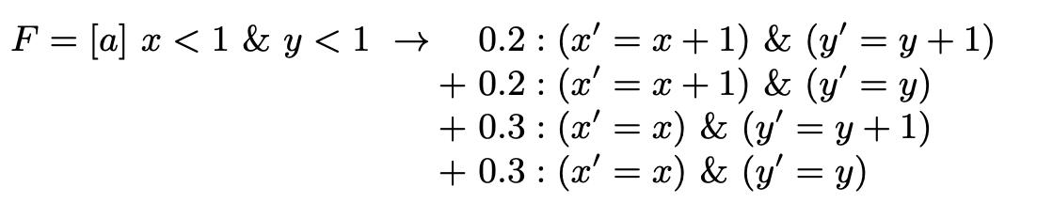
example
Applying the semantics:

Slide 17
PROJECTION

Slide 18
ANNOTATIONS
NB: Only interactions are annotated

Slide 19
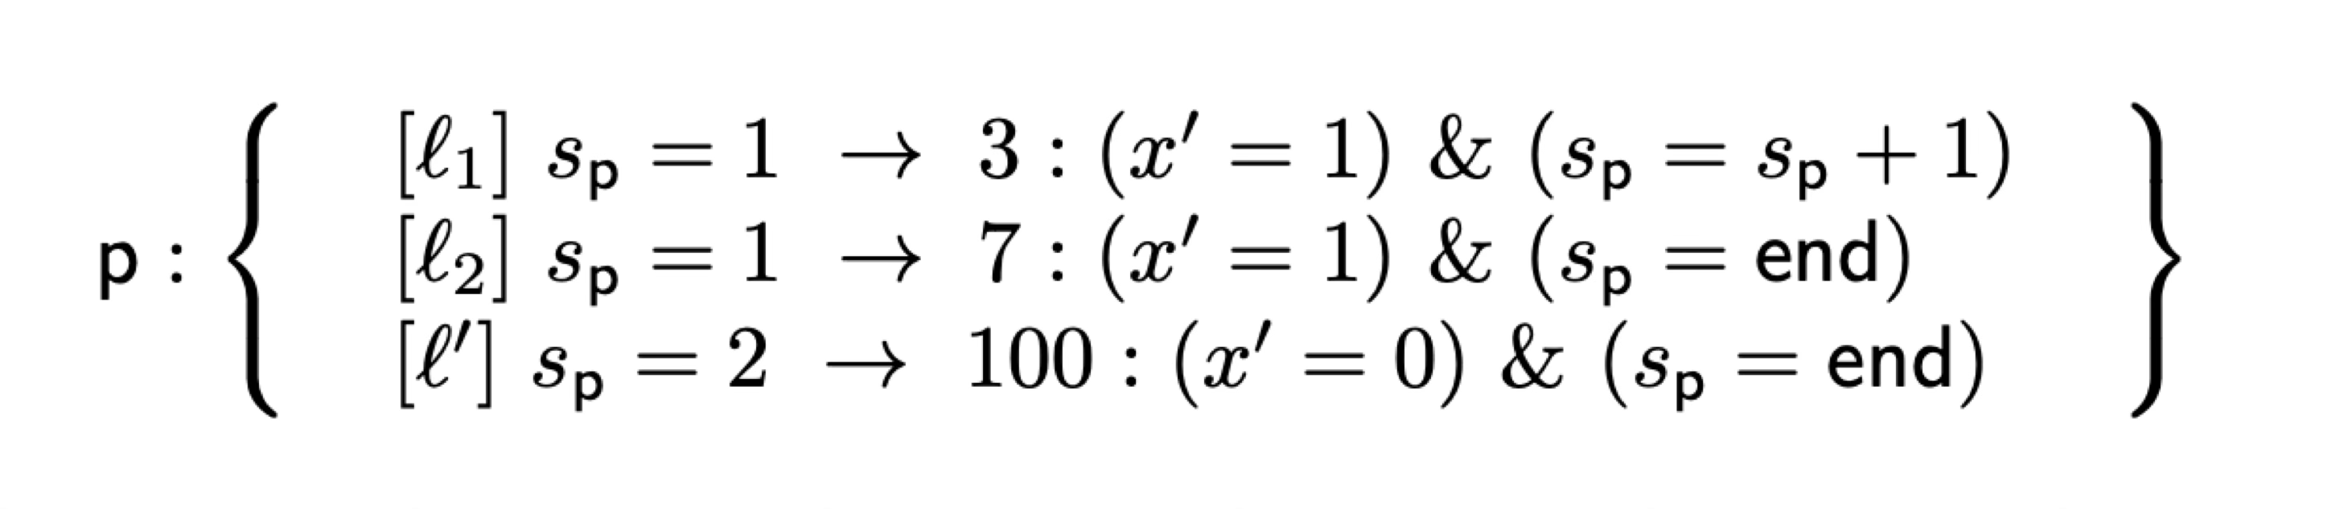
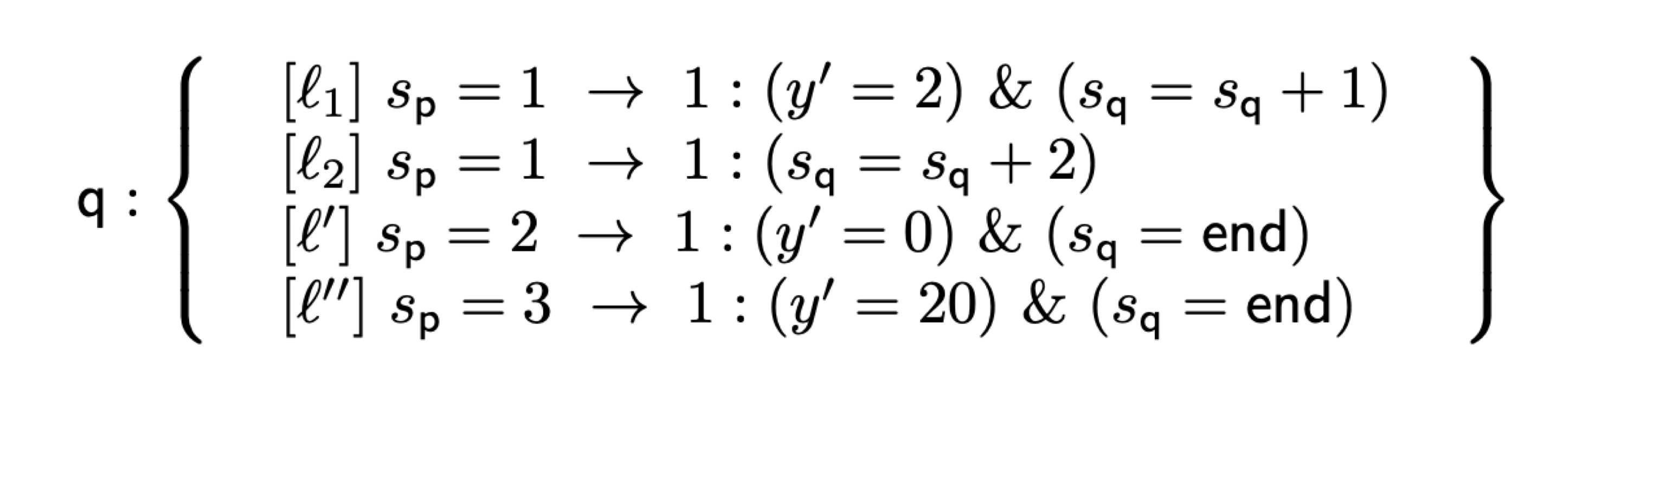
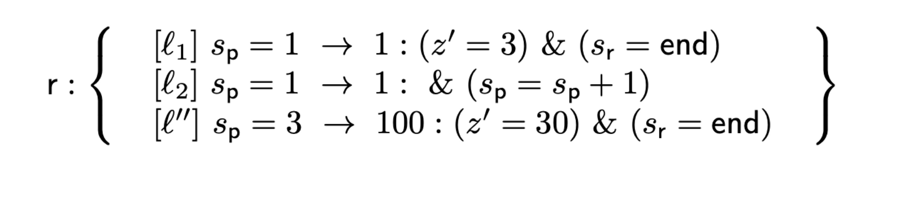
example

Slide 20
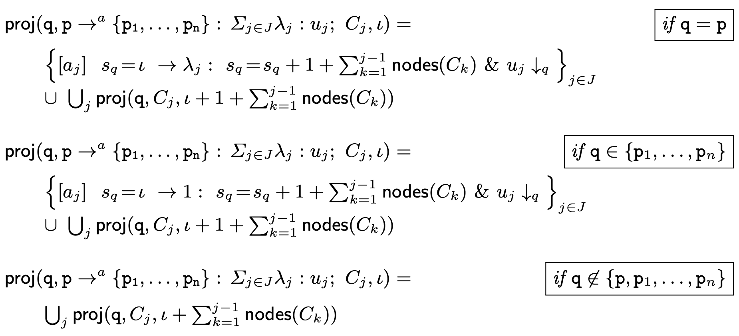
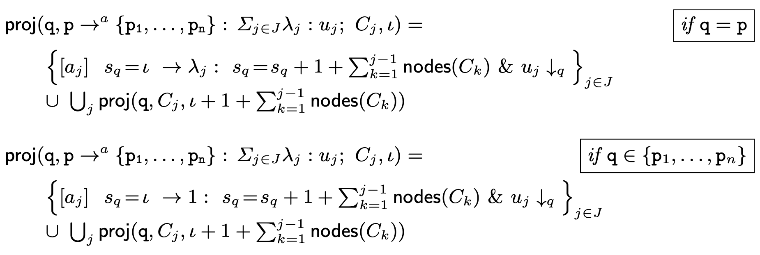
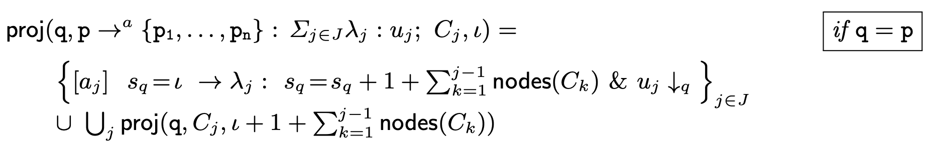



CTMC
Annotated choreographies
a label and an integer identify a node
s_{q} is the counter for this module
nodes(C) returns the number of nodes of C

Slide 21
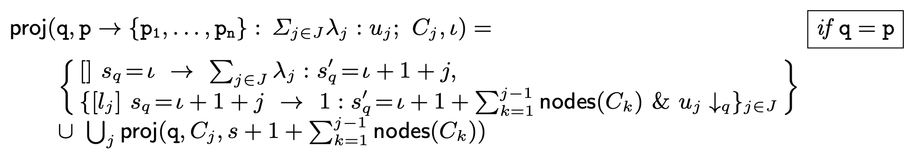
DTMC

Slide 22
correctness
Our projection operations are correct with respect to the semantics of choreographies and PRISM

Slide 23
IMPLEMENTATION & BENCHMARKING

Slide 24





IMPLEMENTATION
In Java, ANTLR
Available at https://github.com/adeleveschetti/ChoreoPRISM
Generates PRISM code that needs to be fed to PRISM
Implementation offers extra language constructs
Parametric modules renaming

Slide 25
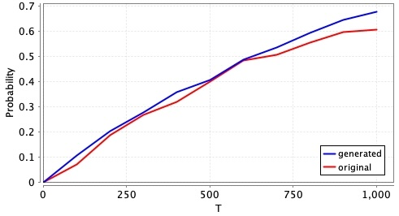
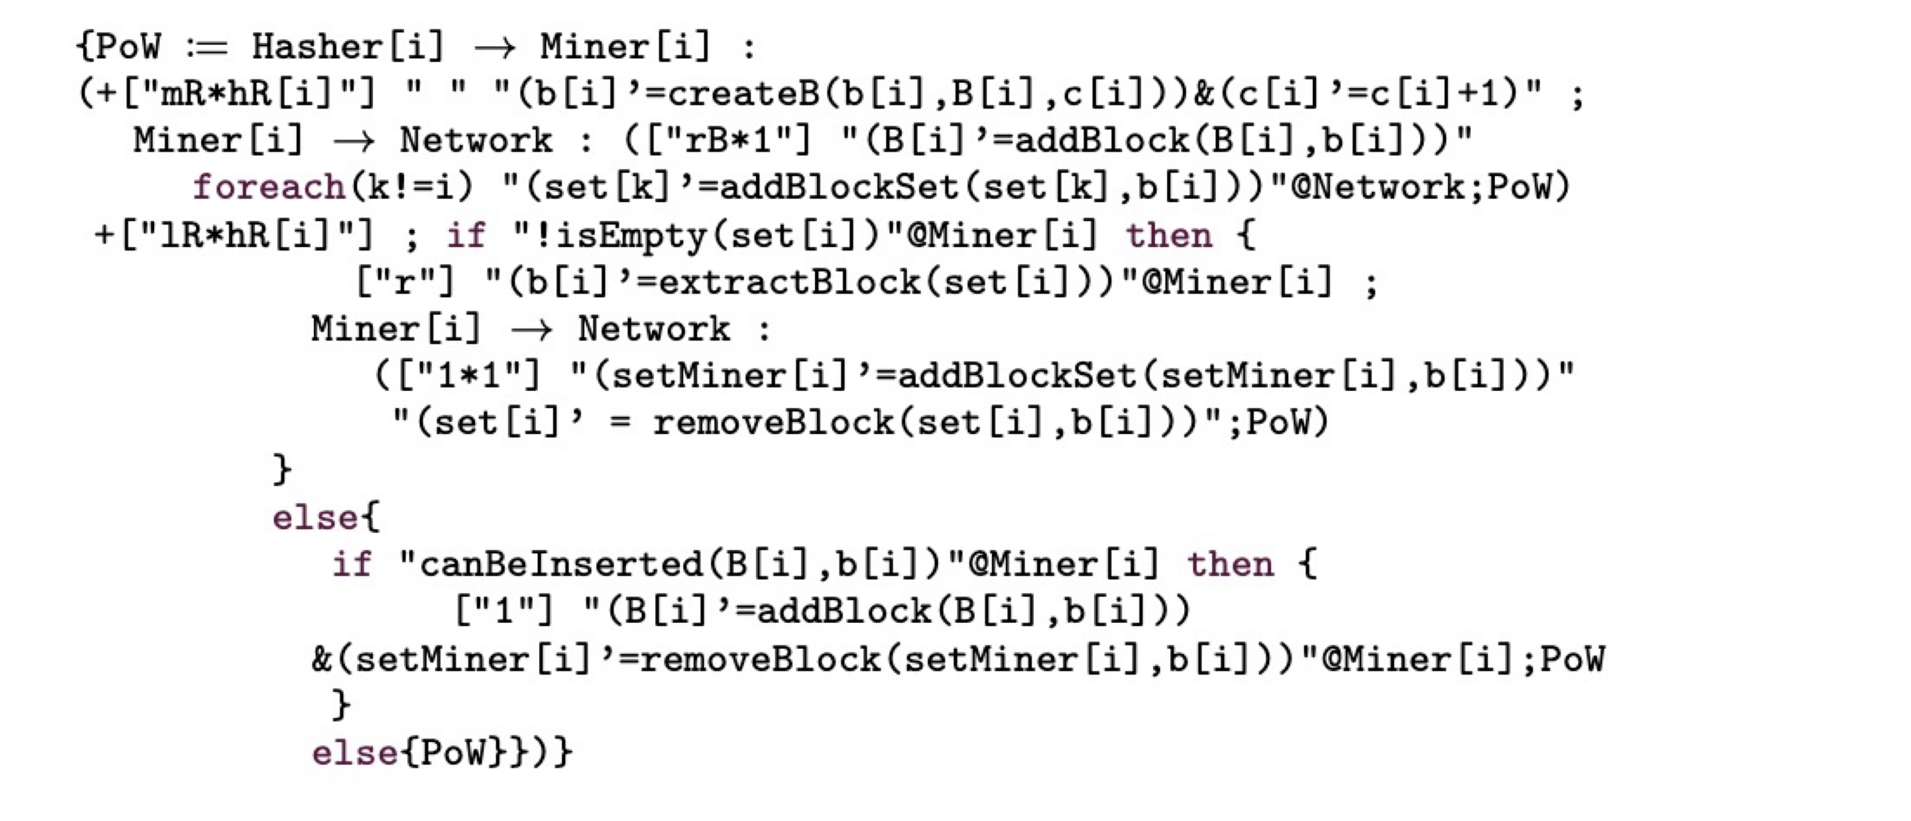
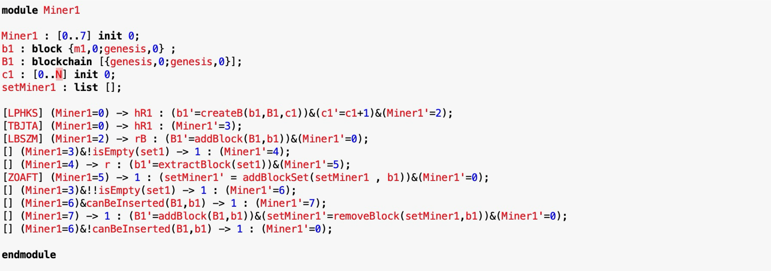
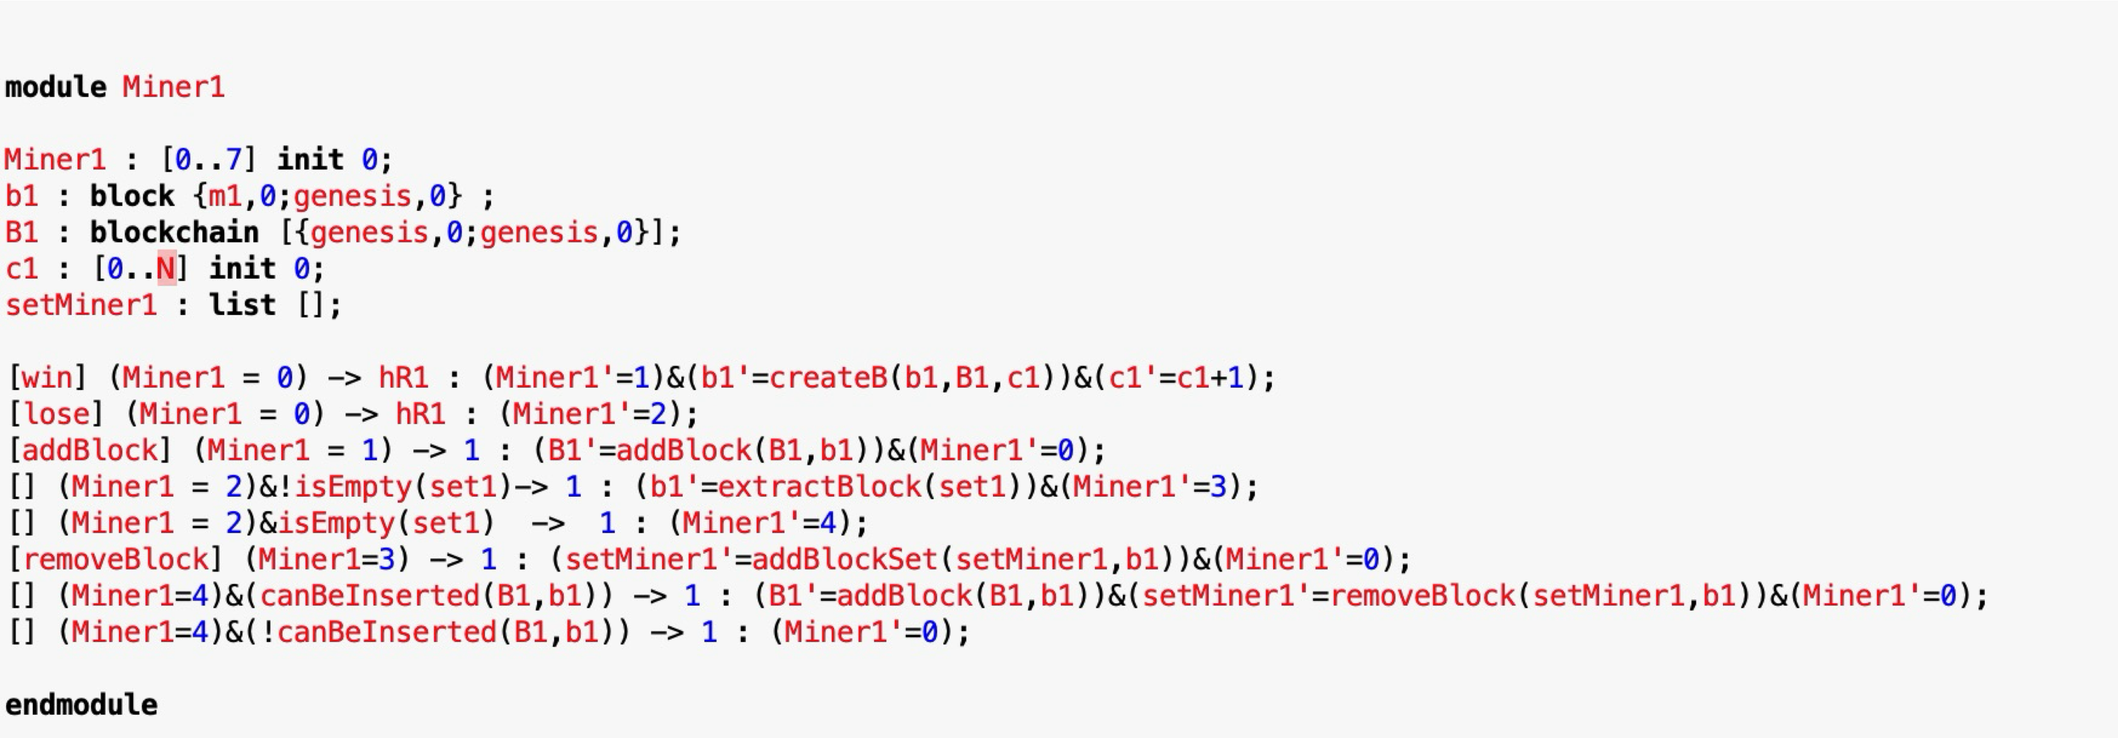
Bitcoin example
Original PRISM Model¹
Choreographic Model
Projected PRISM Model
[1] Stefano Bistarelli, Rocco De Nicola, Letterio Galletta, Cosimo Laneve, Ivan Mercanti, Adele Veschetti: Stochastic modeling and analysis of the bitcoin protocol in the presence of block communication delays. Concurr. Comput. Pract. Exp. 35(16) (2023)

Slide 26
Conclusions & next steps

Slide 27
Conclusions
We have developed a choreographic calculus
Probabilistic
Models concurrent probabilistic systems
Improved expressive clarity
Implemented and proved the correcteness of the projection

Slide 28
What’s next?
Extend the language
There are protocols we cannot model, especially those with internal branching
Extend the theory for the full language (and extensions)
Theoretical aspects only hold for a very core version of the language
Generate Markov chains directly from choreographies
PRISM needs to construct all possible interactions from single modules
A choreography knows that by definition
Can this improve performance dramatically?

Slide 29
THANK YOU!
Questions?
Adele Veschetti
adele.veschetti@tu-darmstadt.de

